Slide 1
Reclassification of Penalties for Low-Level Drug Possession in Illinois: An Overview

Slide 2
What is reclassification?
Currently, the possession of any amount of any illegal drug is always classified as a felony in Illinois.
HB 3447 is legislation that would reclassify the penalty for small-scale drug possession from a felony to a misdemeanor.

Slide 3
Felony vs. Misdemeanor: What’s the difference?
A felony is a crime for which a person may be sentenced to incarceration in the Illinois Department of Corrections (IDOC) for at least 1 year. A person convicted of a felony may also be eligible for a sentence of probation.
The penalty for a misdemeanor is usually probation or another form of community supervision. However, a person convicted of a misdemeanor may be sentenced to incarceration in a county jail (not IDOC) for up to 1 year.

Slide 4
What do we mean by “drug possession”?
HB 3447 would change the penalties for all drugs except cannabis, including:
Heroin
Cocaine
Fentanyl
Methamphetamine
Opioids (OxyContin, Vicodin, etc.)
MDMA/”Ecstasy”
Hallucinogens (LSD, psilocybin mushrooms, etc.)
PCP
. . . and every other substance for which possession is currently classified as a felony under Illinois law.

Slide 5
“Simple” possession vs. “possession with intent to deliver”:
In Illinois, the most commonly charged drug offenses are:
Possession of a controlled substance (“PCS” or “simple” possession); and
Manufacture, delivery, or possession with intent to deliver a controlled substance.
For every drug, the penalty for manufacture/delivery/possession with the intent to deliver is substantially more severe than the penalty for simple possession.

Slide 6
Quantity matters . . . a lot!
In Illinois, the penalty for drug possession depends upon the quantity of the substance involved in the offense. The higher the quantity, the more severe the penalty.
For the smallest amounts (e.g., 15 grams or less of heroin or cocaine), drug possession is usually classified as a Class 4 felony (1-3 years in prison OR up to 2 ½ years probation).
*Exception: Meth possession starts at a Class 3 felony (2-5 years in prison OR up to 2 ½ years probation).
However, if the amount exceeds a certain threshold (e.g., 15 grams for heroin or cocaine), the penalty increases to a Class 1 felony (4-15 years in prison OR up to 4 years probation). If the amount exceeds the next-highest threshold (e.g., 100 grams for heroin or cocaine), then the person may receive a prison sentence of 6-30 years.
Street drugs are often “cut” with other substances to increase dealer profit. But the quantity thresholds apply to any substance *containing* any amount of a prohibited drug.
Example: Under the law, the penalty for possessing 1 gram of pure cocaine diluted with 20 grams of a non-controlled substance is the same as the penalty for possession of 21 grams of pure cocaine.

Slide 7
Drug possession convictions cause severe and longstanding harm to people.
Beyond the negative consequences of incarceration, a past conviction (or even an arrest) for a felony or misdemeanor can have serious consequences for a person, well beyond the completion of their sentence.
People with felony convictions are categorically ineligible for certain types of employment, professional licenses, access to public benefits and housing as a matter of law.
People with felony convictions also experience a high degree of social stigma, often being denied jobs, housing, education, and other opportunities as a result of records that appear on criminal background checks.
While not as damaging as a felony conviction, a misdemeanor record can also have serious collateral consequences for an individual.

Slide 8
How many people are impacted?
From 2016-2018, about 20,000 people were convicted of felonies for small-scale drug possession in Illinois. More than 7,500 of those people went to prison.

Slide 9
How many people are impacted?

Slide 10
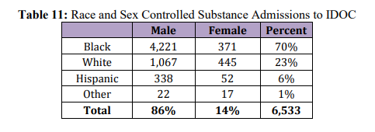
Who gets incarcerated for drug possession in Illinois?
Black people make up a disproportionate percentage of people sent to prison for small-scale simple drug possession offenses:

Slide 11
Who gets incarcerated for drug possession in Illinois?

Slide 12
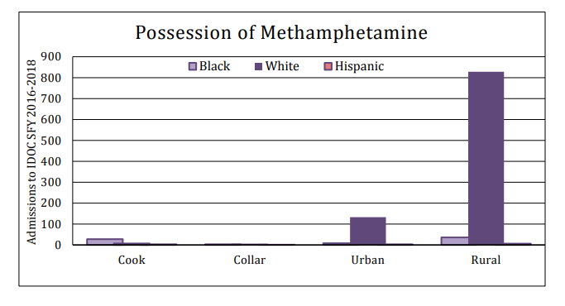
Who gets incarcerated for drug possession in Illinois?
However, meth offenses overwhelmingly impact rural whites:

Slide 13
Who gets incarcerated for drug possession in Illinois?
Women represent a relatively small but growing percentage of the Illinois prison population. Of the approximately 2,500 women imprisoned in Illinois, about 80% are mothers, and approximately 65 percent of their children are minors.
Women imprisoned in Illinois are more likely to have been convicted of a low-level offense than their male counterparts: 31 percent were convicted of a Class 3 or Class 4 felony, compared to 20 percent of incarcerated men. Imprisoned women are also more likely than men to have been convicted of drug crimes (30 percent vs. 18 percent).

Slide 14
Which Illinois counties send the most people to prison for small-scale drug possession?

Slide 15
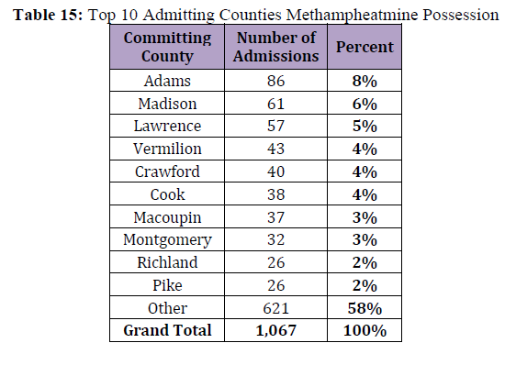
Which Illinois counties send the most people to prison for small-scale drug possession?

Slide 16
Trends in incarceration for drug offenses in Illinois:
Over the past 20 years, Illinois’ prison population has decreased by more than 5,000. While the overall percentage of IDOC’s population serving time for drug offenses during that time has shrunk from 25% to 14%, the percentage incarcerated for simple drug possession has remained constant at 5%.

Slide 17
Trends in incarceration for drug offenses in Illinois:

Slide 18
Trends in incarceration for drug offenses in Illinois:
Illinois’ prison population peaked on February 9, 2013, when 49,401 people were incarcerated in IDOC. Since then it has declined by 20% (still 7,000+ in excess of its design capacity.
According to Loyola University research, a substantial portion (14%) of the recent statewide decrease in Illinois’ prison population is attributable specifically to fewer arrests for felony drug‐law violations in three specific police districts in Chicago, “just like the tripling and quadrupling of arrests in Chicago in the late ‘80s tended to be concentrated in very specific neighborhoods.”

Slide 19
What is being done to fix this problem?
The Reducing Barriers to Recovery initiative (HB 3447) is a bill in the Illinois General Assembly that, if passed into law, would reclassify the penalty for possession of small amounts of drugs from a felony to a Class A misdemeanor, and offer real diversion in the form of behavioral health assessments and access to treatment for people who need it, instead of incarceration.

Slide 20
How would HB 3447 change the law?
1. Sentencing Reform for small-scale simple drug possession:
HB 3447 would create new quantity thresholds, below which the penalty for simple drug possession would be reclassified as a Class A misdemeanor rather than a felony.
For instance, the bill provides that possession of 5 grams or less of cocaine, or 3 grams or less or heroin, fentanyl or methamphetamine, would be classified as a Class A misdemeanor. Possession of amounts above the new thresholds would remain a felony.
The bill would also eliminate possession with intent to deliver (PWID) charges for amounts under the new thresholds. Currently, PWID carries the same penalty as manufacture or delivery of a controlled substance. The bill would not change the penalties for manufacture or delivery of any amount of a controlled substance.

Slide 21
How would HB 3447 change the law?
2. Misdemeanor Diversion Program:
At the judge’s discretion, a person charged with any misdemeanor offense (other than a “violent” offense or a crime involving a gun), would be eligible for the program.
If the person agrees to comply with the terms of the program, the criminal case would be suspended while they obtain:
An evaluation to determine whether they have substance use, mental health, or other social service needs; and
If the evaluation indicates that the person has such needs, a comprehensive assessment and service plan.
Compliance with the terms of the program would result in dismissal of the charges, and the person would be immediately eligible to petition the court to seal or expunge their record.

Slide 22
How would HB 3447 change the law?
3. Retroactivity:
Under HB 3447, a person already serving a sentence could petition the court to reduce their sentence under the new law; and
A person who has previously completed a sentence could petition the court to enter an order designating their prior felony conviction as a misdemeanor.

Slide 23
How would HB 3447 change the law?
4. Expungement:
HB 3447 would allow records of misdemeanor drug possession convictions to be expunged 5 years after the person completes their sentence. A person who was previously convicted of a felony, and whose conviction was reduced to a misdemeanor at a resentencing hearing, would be eligible for the same relief.
Expungement would not be automatic; rather, the individual would be required to petition the court for expungement, and prosecutors would have standing to object.

Slide 24
Who supports reclassifying sentences for low-level drug possession?
More than three-quarters of Illinois voters (79%) surveyed in early 2021 support making simple possession of small amounts of drugs a misdemeanor and reducing sentences for all drug offenses.
This policy was also recommended by the bipartisan Illinois State Commission on Criminal Justice and Sentencing Reform in its Final Report in 2016.

Slide 25
Who supports reclassifying sentences for low-level drug possession?
HB 3447 is supported by a diverse coalition of advocates and stakeholders from across Illinois including public health experts, criminal justice advocates, law enforcement officials, treatment providers, faith leaders, workforce developers, and people directly impacted by the criminalization of addiction:
ACLU of Illinois
BPI Chicago
Buddy’s Purpose
Cabrini Green Legal Aid
Chicago Appleseed Center for Fair Courts
Chicago Coalition for the Homeless
Chicago Community Bond Fund
Chicago Recovery Alliance
Chicago Urban League
Clergy for a New Drug Policy
Communities United
Cook County
Cook County State’s Attorney
Communities United
Dusty Roads
Heartland Alliance
Illinois Association for Behavioral Health (IABH)
Illinois Justice Project
Illinois Religious Action Center of Reform Judaism (RAC-IL)
Lake County Sheriff
Law Office of the Cook County Public Defender
Live4Lali
Perfectly Flawed Foundation
Revolution Workshop
Shriver Center on Poverty Law
Students for a Sensible Drug Policy
Target Area Development Corporation
TASC, Inc.
Women’s Justice Institute

Slide 26
How can people learn more, or get directly involved in helping to pass HB 3447?
For more information, please contact:
Ben Ruddell bruddell@aclu-il.org
Patrice James patricejames@povertylaw.org
Jessica Estrada jessica@communitiesunited.org

